Slide 1
Introduction
Business Model and Website
Bucktown Fitness Gym
Development Team
Heidi Fleck - Designer
Geoff Brown – Development
Tobin Cheuk – Development
Shane Burns – Business Analyst
Presentation Demo Overview

Slide 2
E-Commerce Value Chain
Website Value Proposition
Marketing and Advertising Campaign
Strategy to Attract Different Types of Customers
Impulsive
Patient
Analytical

Slide 3
E-Commerce Value Chain
Tools and Features to enhance customer experience
Order Placement Processing
Processing Delivery, Shipping, and Returns
Customer Service and Support

Slide 4
Information Architecture

Slide 5
Site Structure & Design

Slide 6
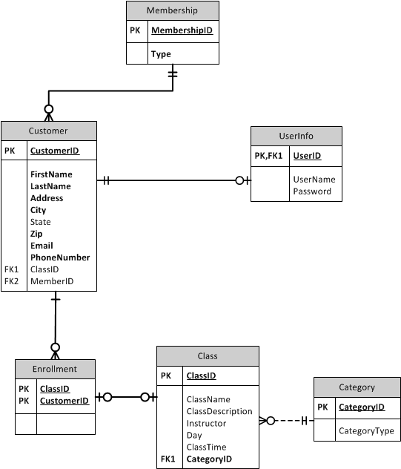
Entity relationship diagram

Slide 7
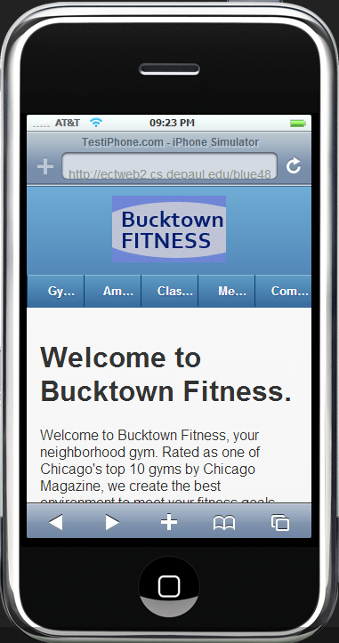
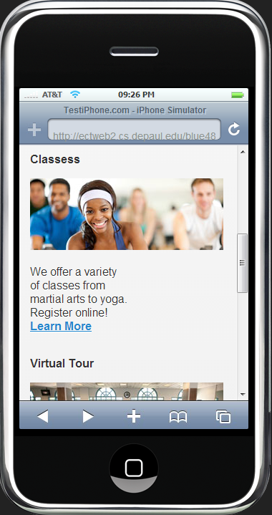
Jquery mobile version of main site

Slide 8
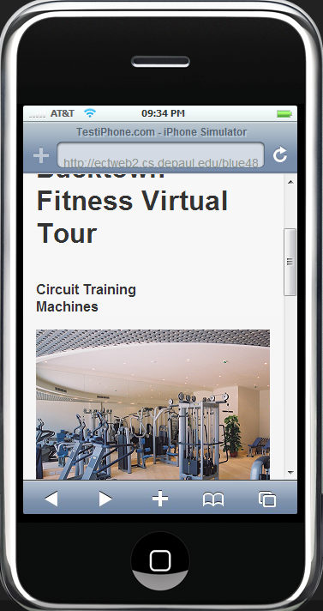
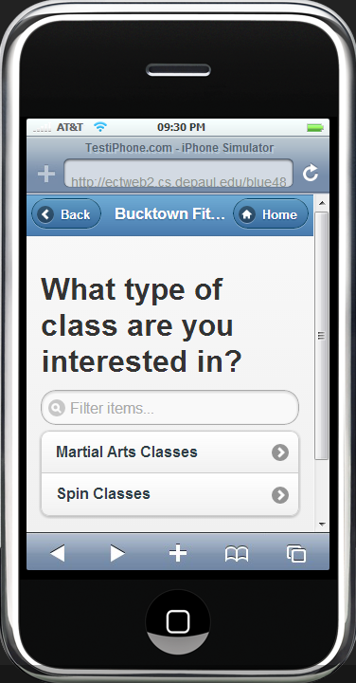
Virtual tour and class selection

Slide 9
Usability Testing
Personas
Primary: Existing members, Bucktown residents
Secondary: Member of competing gym
Test Scenarios
Sign up for trial membership
Post a message on community board
Complete virtual tour

Slide 10
Usability Results
Identified 4 necessary changes for Sprint 3:
Fix Membership Form Submission

Slide 11
Form Submit Before

Slide 12
Form Submit After

Slide 13
Usability Results
2. Update Virtual Tour Photos

Slide 14
Virtual Tour Before

Slide 15
Virtual Tour After

Slide 16
Usability Results
3. Improve Discussion Board Experience

Slide 17
Community Discussion Before

Slide 18
Community Discussion After

Slide 19
Community Discussion After

Slide 20
Community Discussion After

Slide 21
Usability Results
4. Align Membership Form Fields

Slide 22
Membership Form Before

Slide 23
Membership Form After

Slide 24
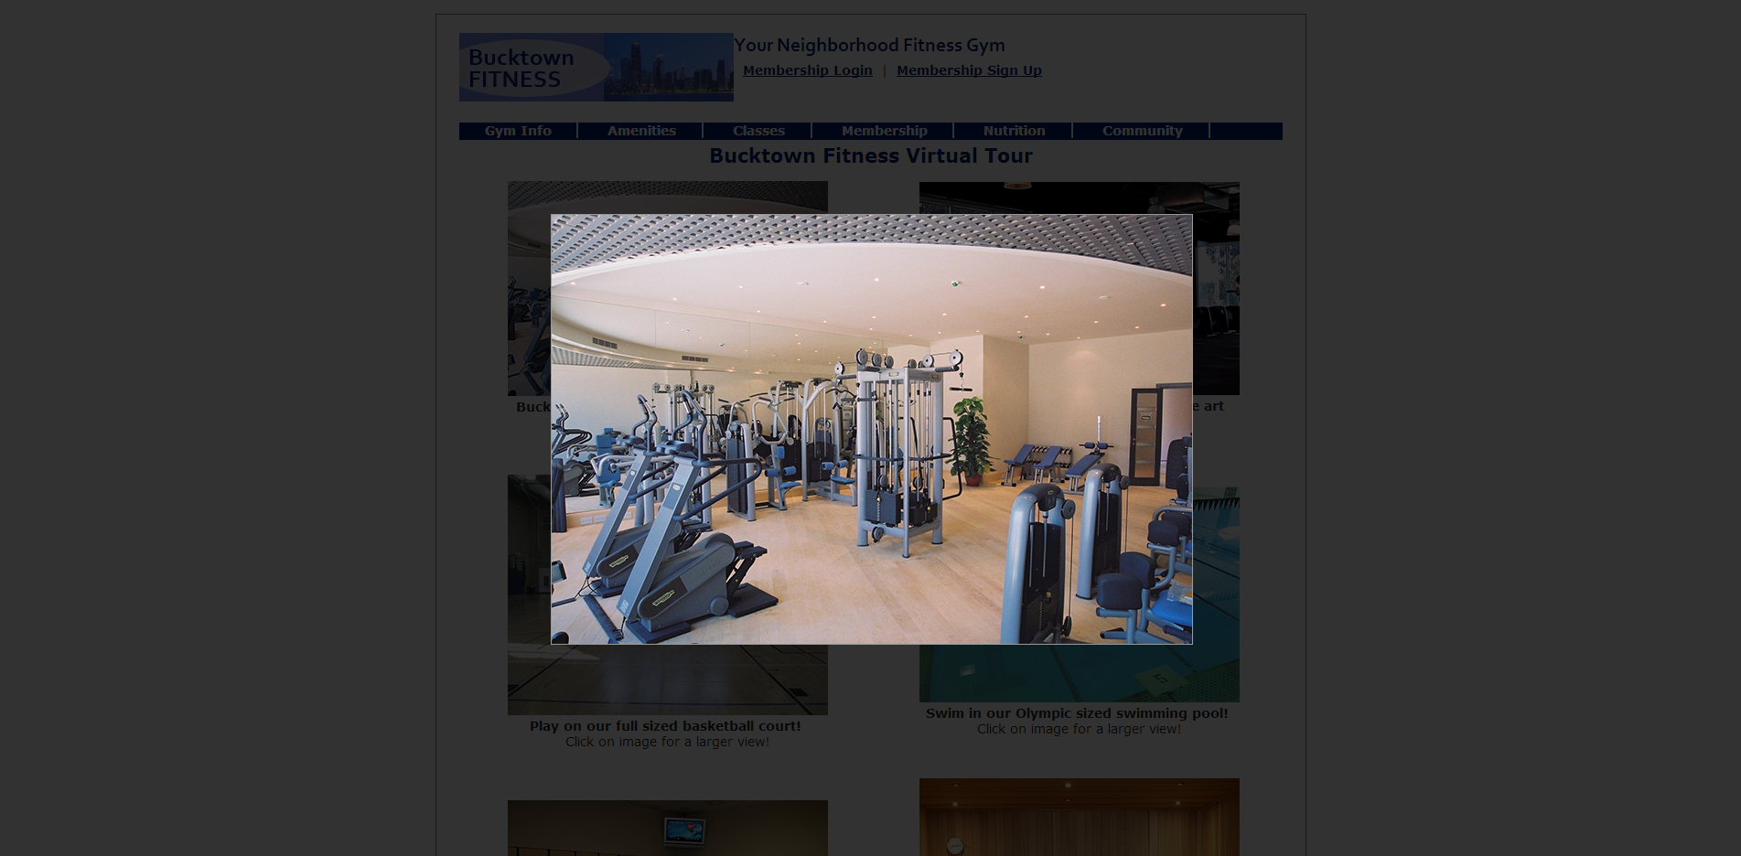
jQuery Implementation using YoxView

Slide 25
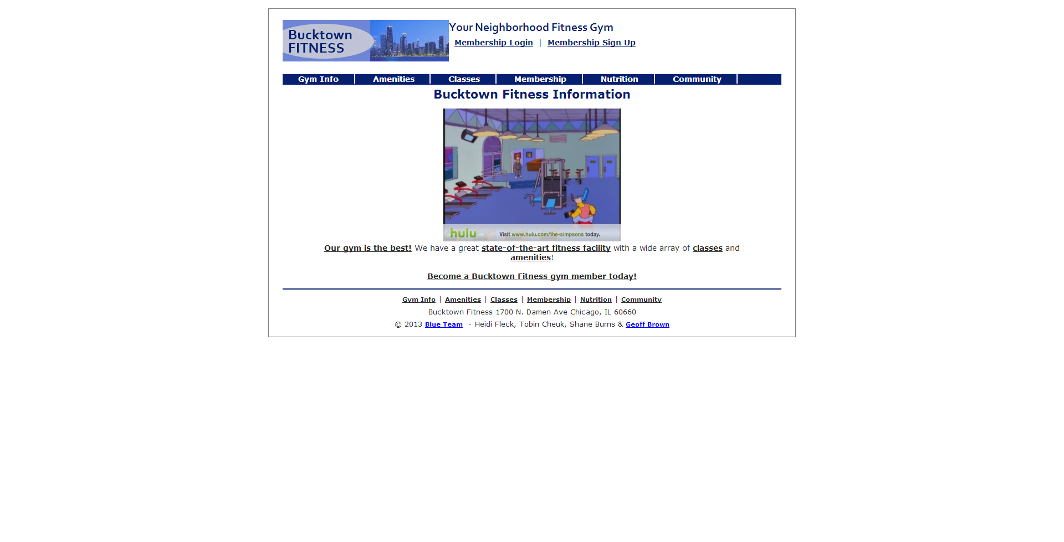
HTML5 Video Implementation

Slide 26
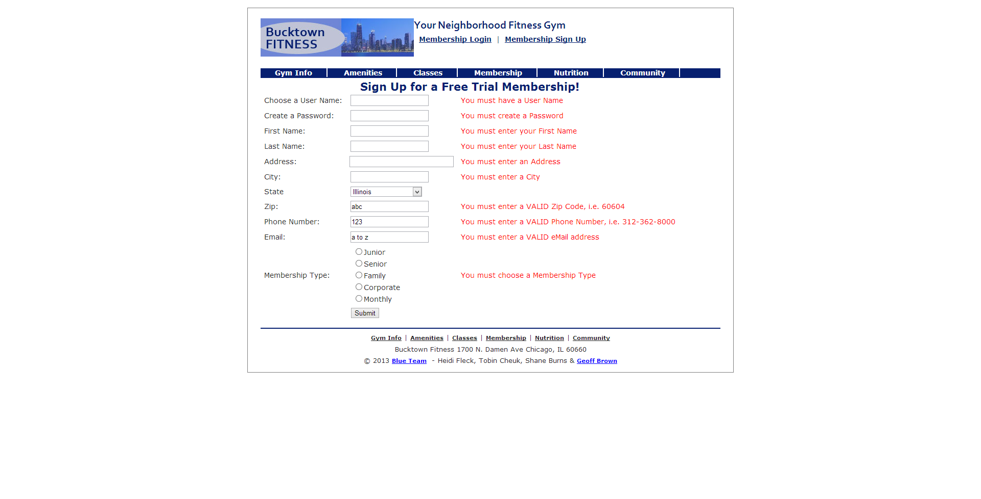
ASP.NET Validation

Slide 27
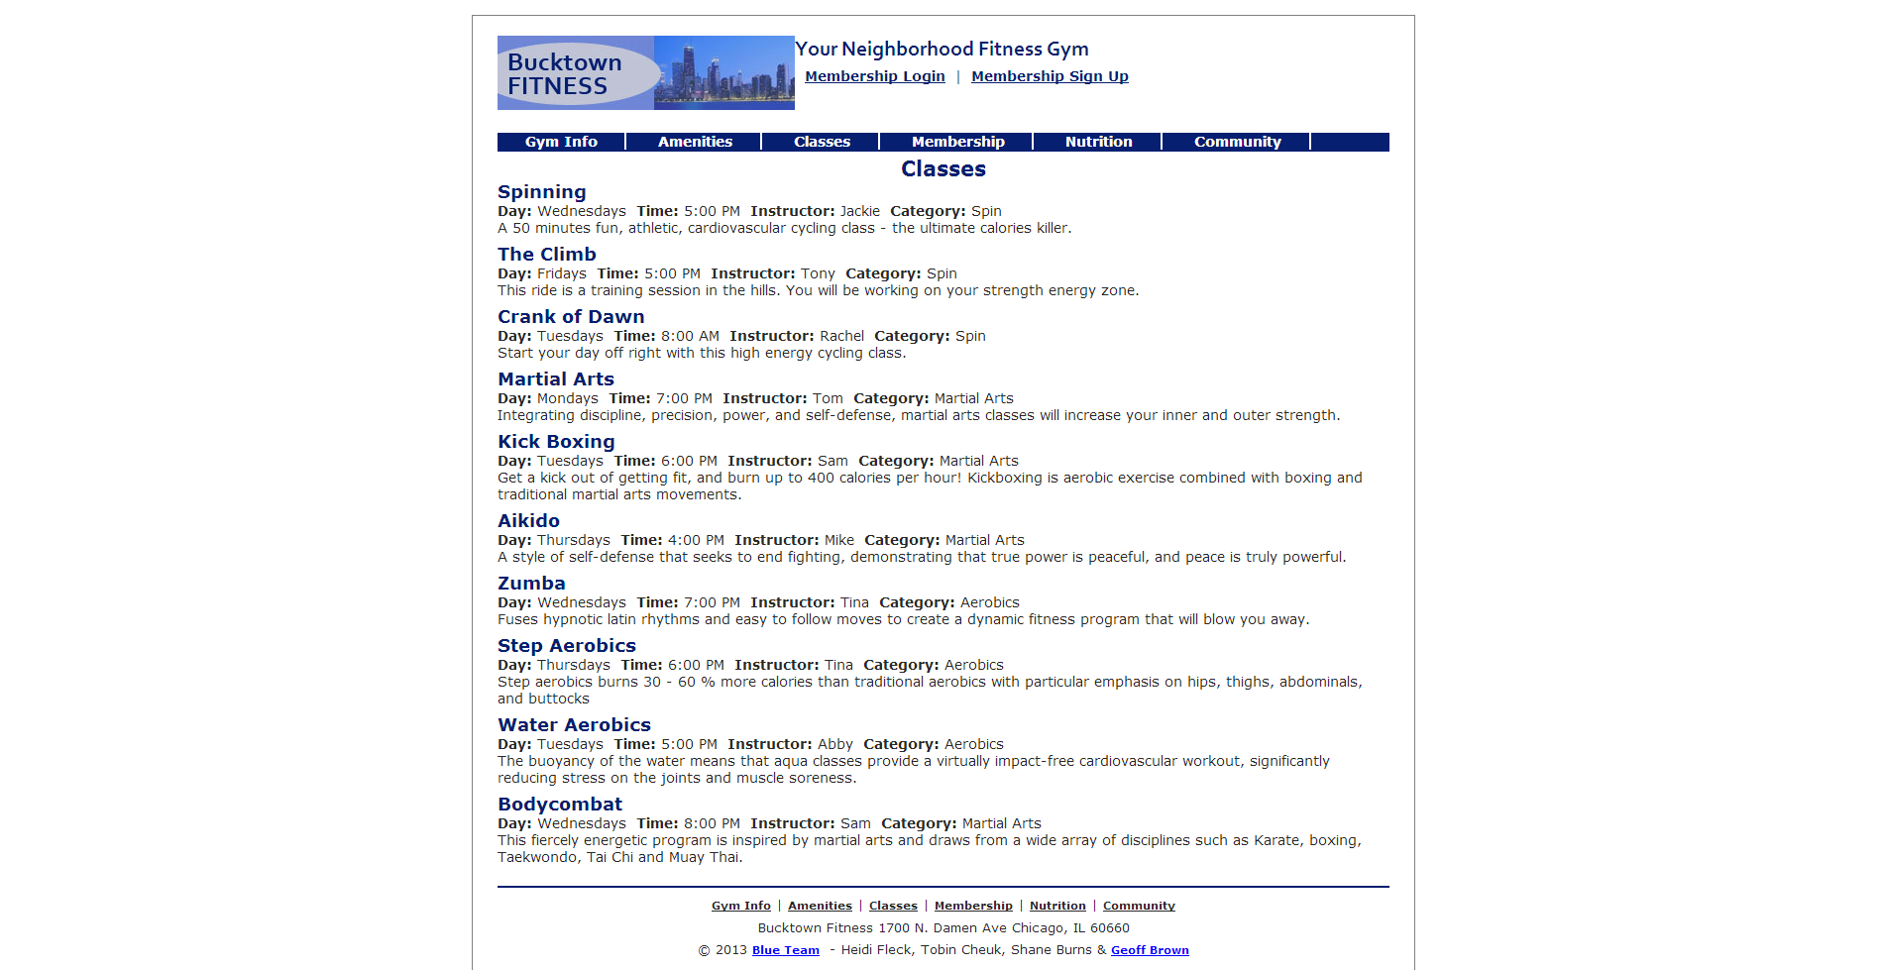
Data Layer Integration

Slide 28
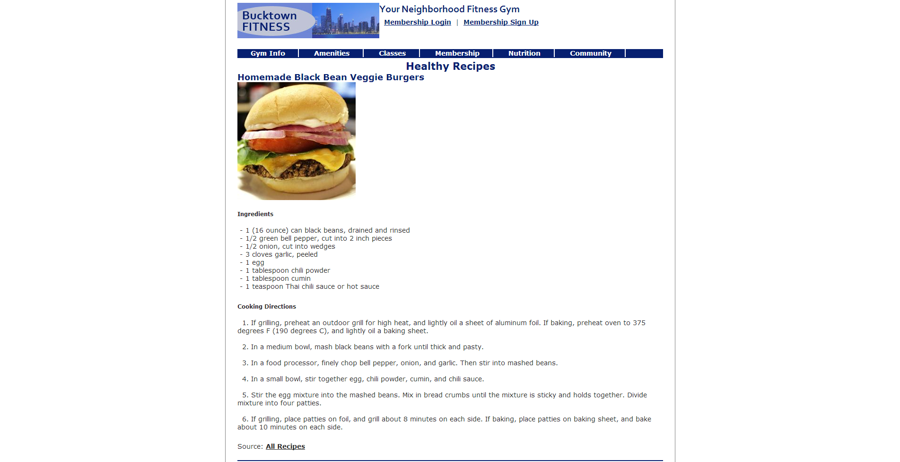
Content on Every Page

Slide 29
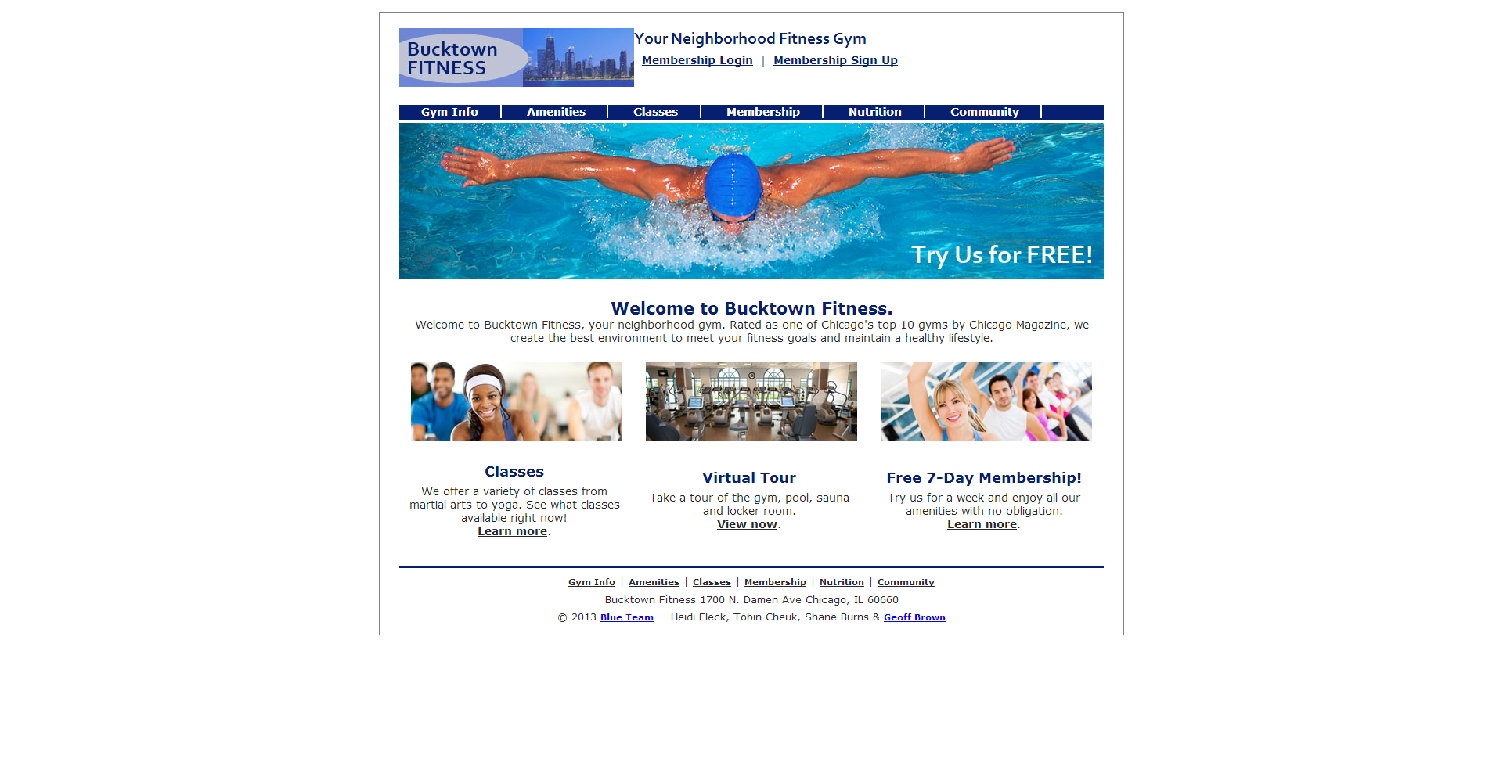
Finished Product

